Slide 1
MENTAL HEALTH TRENDS AND ASSOCIATED FACTORS AMONG WORKING POPULATIONS
ANALYZING AND VISUALIZING FACTORS INFLUENCING MENTAL HEALTH STATUS
BY
ADEDUYITE PRECIOUS OMOLARA

Slide 2
INTRODUCTION
Mental health is a major public health concern globally.
Mental health is an important part of overall wellbeing. It affects how individuals think, feel, behave and relate with others
Stress, mood swings, and coping struggles affect daily life and work performance.
Occupational, social, and behavioral factors can influence mental health outcomes.
Poor mental health may reduce productivity and affect relationships.
Power BI helps to visualize and analyze mental health data effectively.

Slide 3
PROBLEM STATEMENTS
Rising levels of stress and mental health challenges affect productivity
Many individuals struggle with coping mechanisms
Understanding influencing factors is important for intervention
Organization need data-driven mental health strategies

Slide 4
OBJECTIVES
Broad objective: to analyze mental health trends and associated factors using powerbi
Specific objectives include;
To assess stress levels among respondents
To examine coping struggles and behavioral changes
To evaluate occupational influences on mental health
To identify key factors influencing stress and treatment behaviours

Slide 5
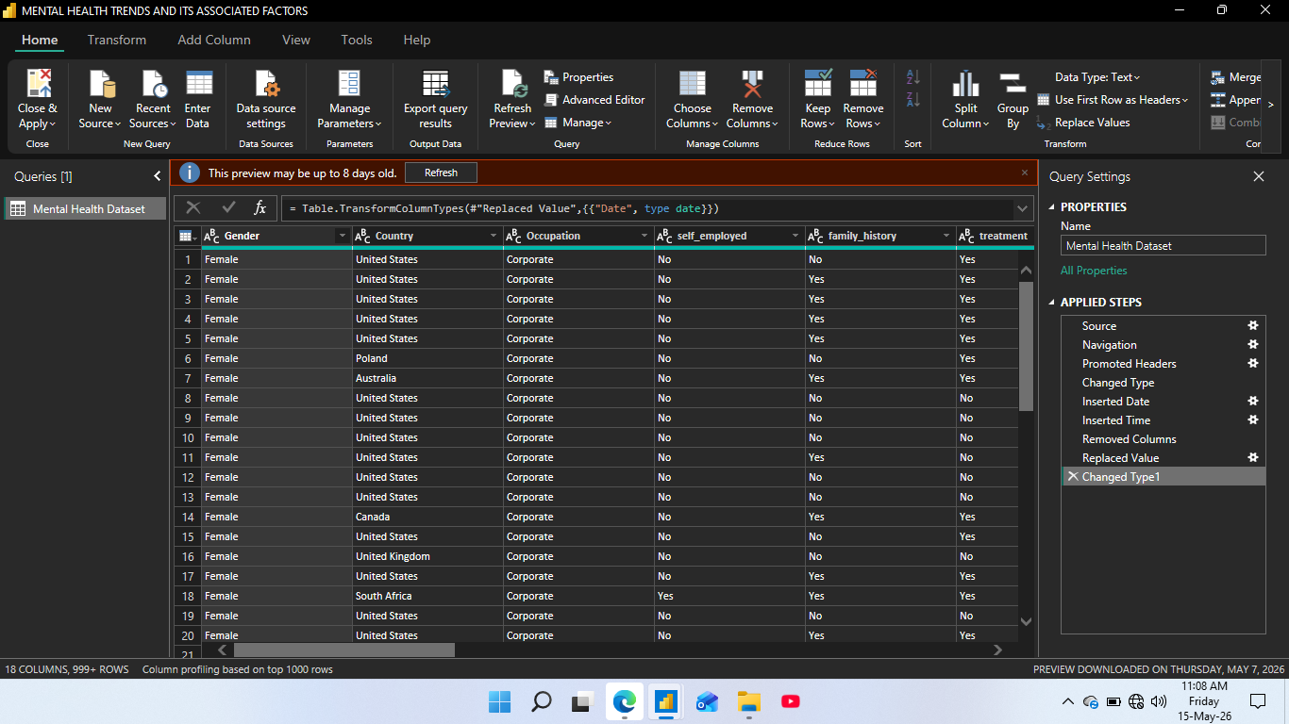
METHODOLOGY
Dataset was imported into Power BI.
Data cleaning was carried out using Power Query.
Interactive visuals and dashboards were created.
DAX measures were used for KPI cards.
Key Influencers visual was used to identify major factors.

Slide 6
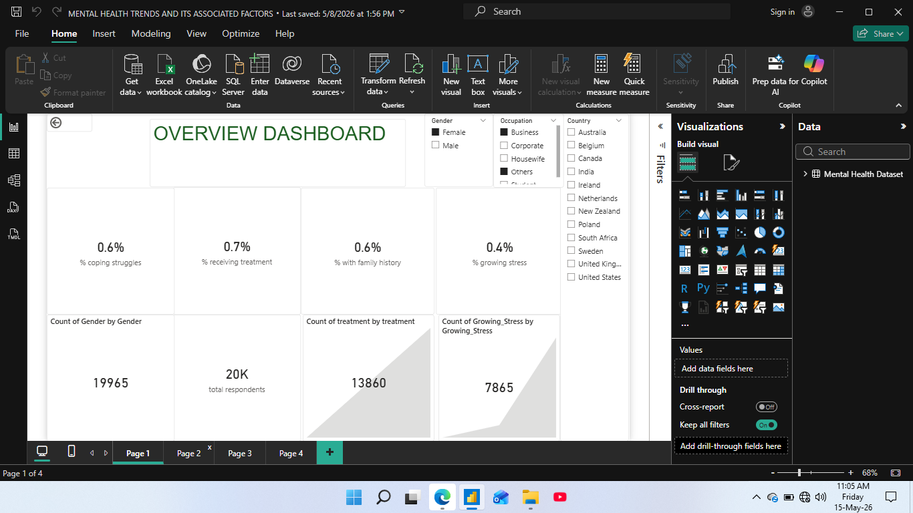
DATA DESCRIPTION
Datasets contains mental health related variables which includes;
Gender
Occupation
Treatment
Family history
Mood swing data
Growing stress and others

Slide 7
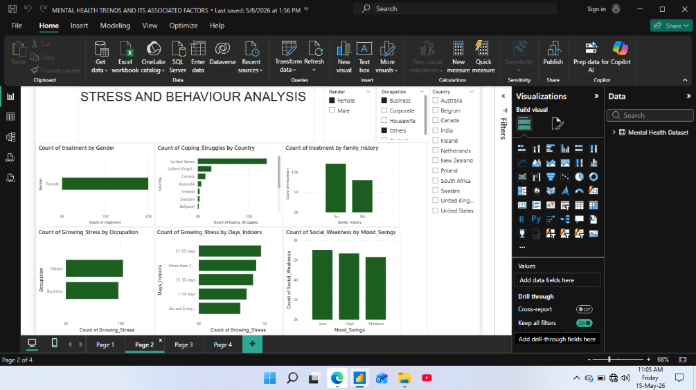
STRESS AND BEHAVIOURAL ANALYSIS
Male respondents recorded higher treatment counts compared to females.
The United States showed the highest level of coping struggles.
Housewives and students experienced higher levels of stress.
Longer indoor stay increased stress levels.
Mood swings were strongly linked with social weakness.

Slide 8
DISCUSSION OF STRESS FINDINGS
Behavioral and occupational factors influenced mental health outcomes.
Prolonged indoor stay contributed to stress and coping difficulties.
Emotional instability affected social interactions.
Academic pressure and daily responsibilities may explain higher stress level among students and housewives.
The findings highlight the importance of stress management and emotional support system.

Slide 9
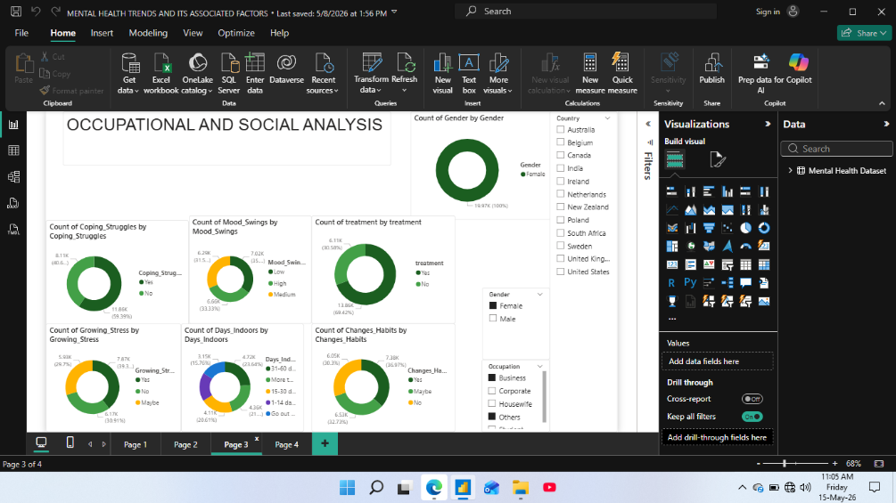
OCCUPATIONAL AND SOCIAL ANALYSIS
Male respondents formed the majority of participants.
Many respondents reported coping struggles.
Moderate and high mood swings were common.
Many participants experienced growing stress and behavior changes.
Treatment-seeking behavior varied among respondents.

Slide 10
DISCUSSION OF OCCUPATIONAL AND SOCIAL FINDINGS
Occupational and social conditions affected mental health experiences.
High coping struggles and mood swings showed emotional stress.
Behavioral changes reflected the impact of stress on daily life.
Differences in treatment-seeking behavior may be linked to awareness and access to support system
The findings emphasizes the need for mental health interventions and awareness programs are needed.

Slide 11
KEY INFLUENCER ANALYSIS
Work interest influenced growing stress levels.
Lower work interest showed higher stress prevalence.
Longer indoor stay contributed to coping struggles.
Gender and country influenced treatment patterns.
Behavioral and environmental factors affected mental health outcomes.

Slide 12
SUMMARY
Stress and coping struggles were linked with behavioral and occupational factors.
Longer indoor stay increased stress and emotional difficulties.
Mood swings contributed to weaker social interactions.
Power BI helped identify important mental health patterns.
Mental health support and early intervention are important.
Males represented the larger proportion of respondents and treatment patterns
Work interest significantly influences stress outcomes
The united state showed notably high coping struggle counts

Slide 13
RECOMMENDATION
Workplaces should provide mental health support.
Stress management programs should be encouraged.
Mental health awareness should be increased.
Counseling services should be made available.
People should maintain healthy social relationships.
Health organizations should use data for mental health planning.

Slide 14
CONCLUSION
Stress, coping struggles, and mood swings affected mental health outcomes.
Occupation and indoor stay influenced stress levels.
Power BI helped identify important mental health patterns.
Mental health support and early intervention are needed.
Awareness programs can improve mental wellbeing.

